Slide 1
Building .NET MAUI applications in CI-CD
GitHub Actions or Azure DevOps
Prepared by: Lance McCarthy
Presented by: Rick Hellwege

Slide 2
Agenda
Quick CI builds for .NET MAUI
Why Bother?
GitHub Actions demo walkthrough
Release builds for .NET MAUI (CI and CD).
Why Bother?
GitHub Action demo walkthrough
Final tips & takeaways

Slide 3
Frequent builds (CI)
Your day-to-day sanity check
Notes:
First, let’s talk about the normal buids that get triggered on your merges into the main working branch

Slide 4
Why bother with cI (main)?
It is a “sanity check” to make sure your code is working, especially in larger solutions where small changes in one project may have unforeseen consequences in other projects.
You have confidence in merging branches (i.e., main -> release). Pull Requests in GitHub can be configured to prevent merging unless the origin branch’s workflows have succeeded.
A historical timeline shows trends. If you don’t delete broken builds in the history, you can easily see where there were more problems than usual

Slide 5
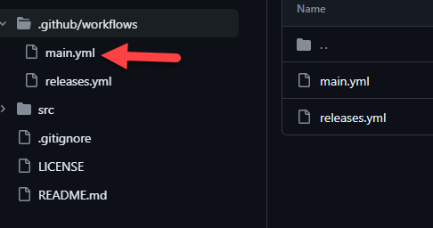
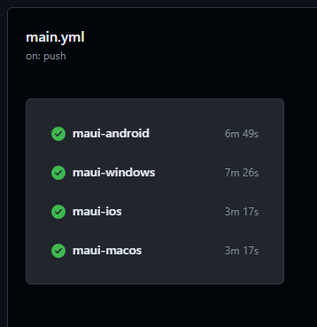
Main branch - Live demos
Available at https://github.com/LanceMcCarthy/BostonCodeCamp36Demo

Slide 6
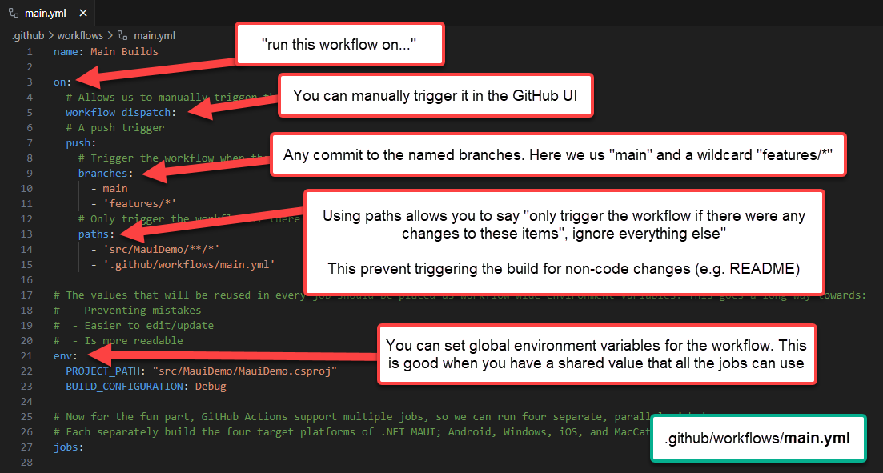
Workflow configuration

Slide 7
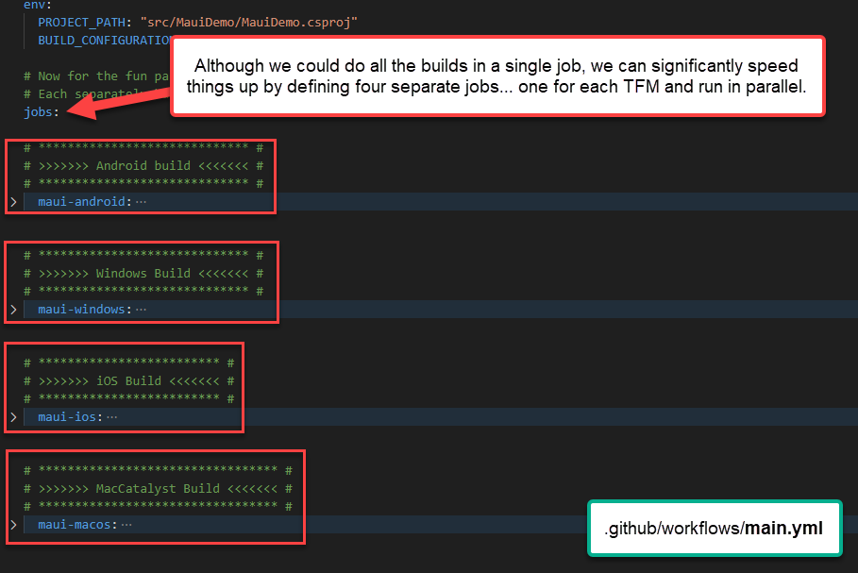
Workflow configuration

Slide 8
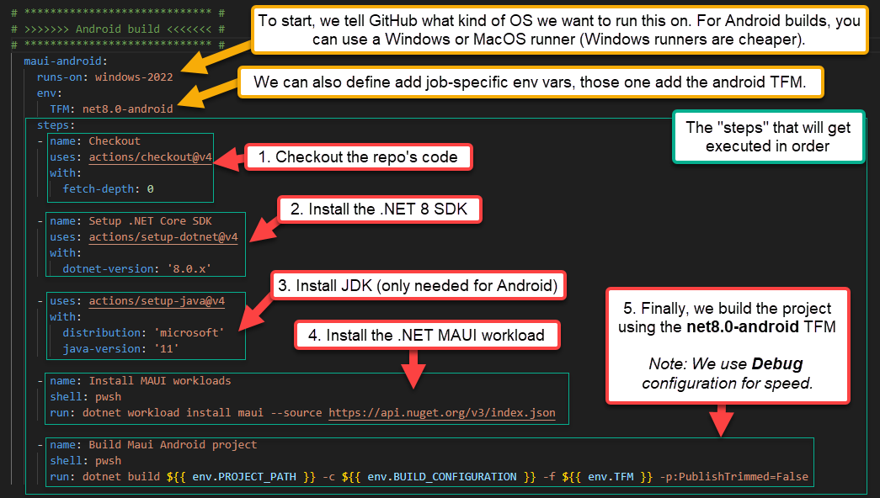
Android build (debug)

Slide 9
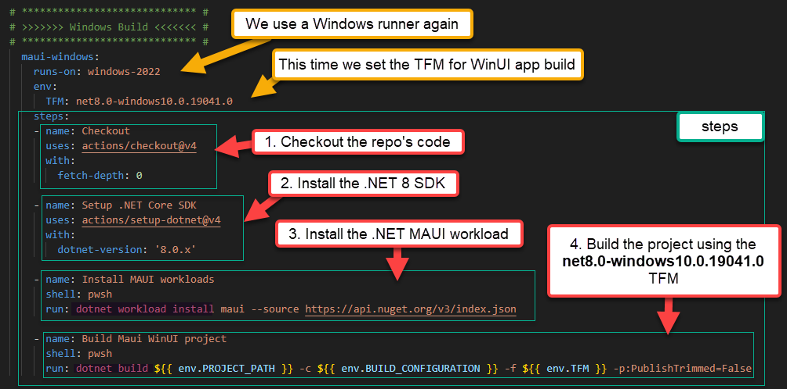
windows build (debug)

Slide 10
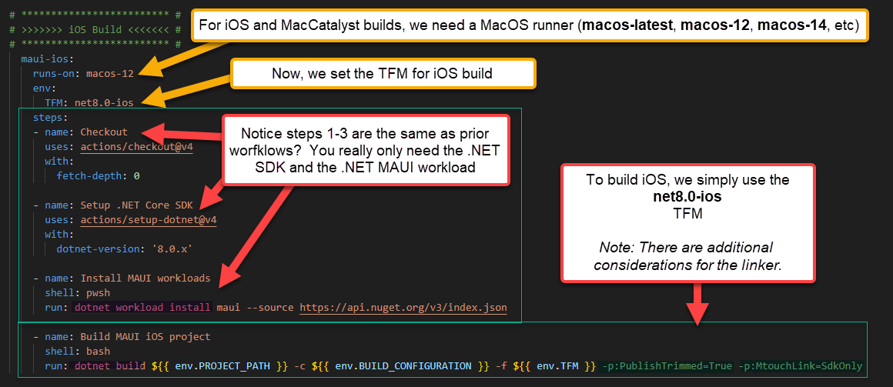
ios build (debug)

Slide 11
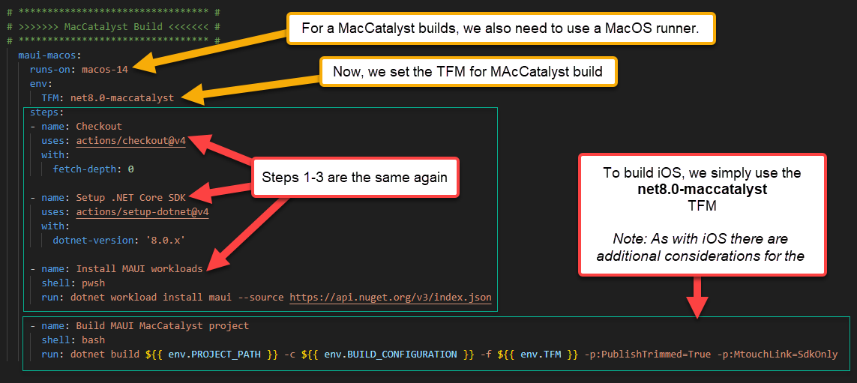
maccatalyst build (debug)

Slide 12
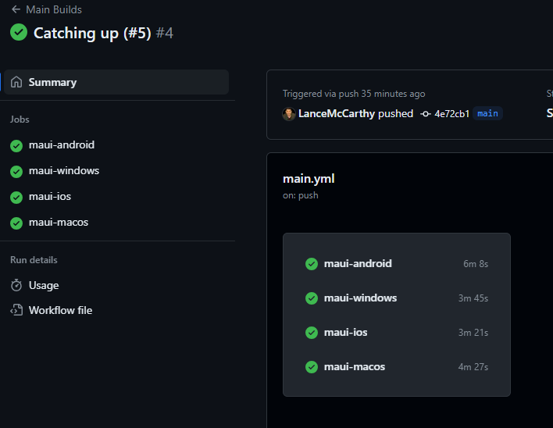
results
When the workflow completes, you see a high-level results overview of all the jobs

Slide 13
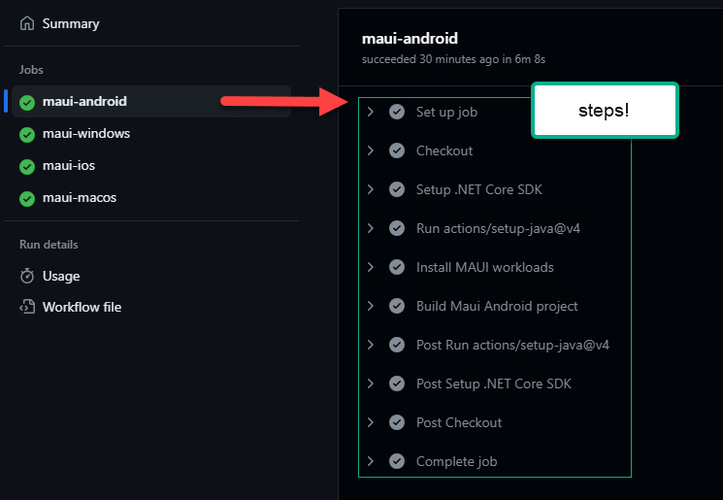
results
Selecting a job will show you the details of that job in the right pane.

Slide 14
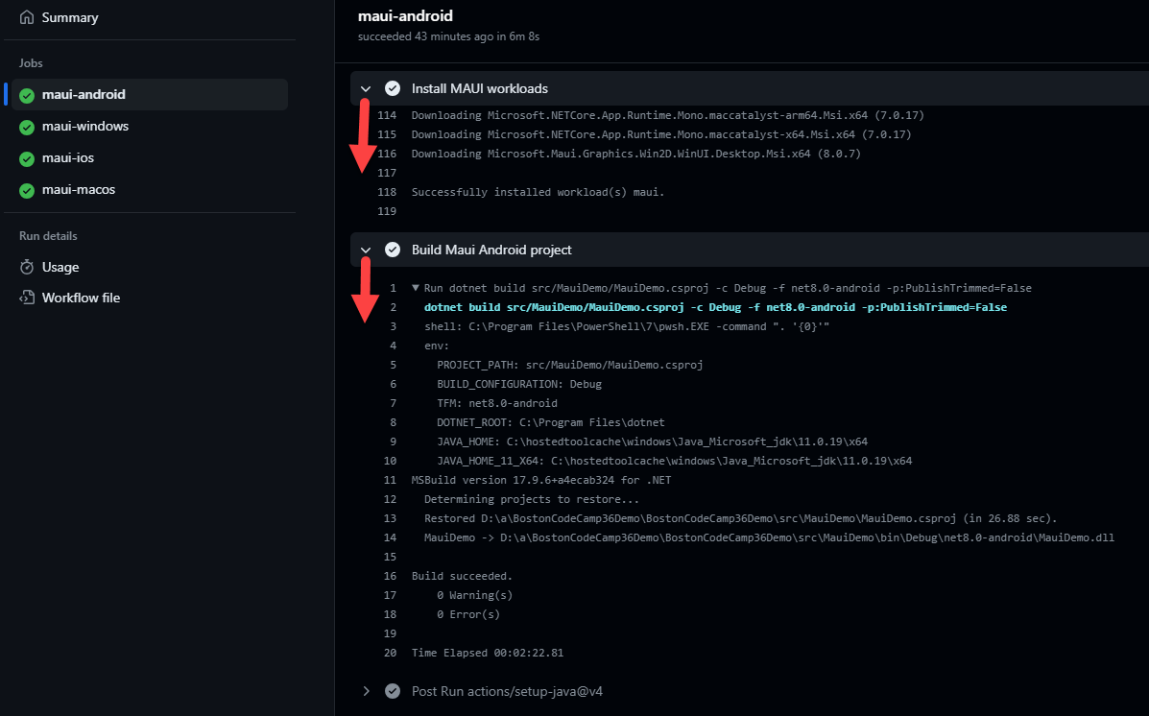
results
Expanding a step will show you the console output for all of its operation.

Slide 15
release builds
Automated real-world releases

Slide 16
Why bother with CI-CD (release)?
Having release workflows alleviates the tedious work of publishing app updates to the various app stores.
You can code sign and distribute through all the various channels you need at the same time (store, side load distribution, in-GitHub release channels, etc)
Automatic versioning
Updating code signing certificates and profiles is a breeze.
You can use an HSM-backed codesigning certificate with ease (azsigntool)
Easier staging, just push to a specific branch, and that workflow handles the rest (e.g. main, prerelease, release)

Slide 17
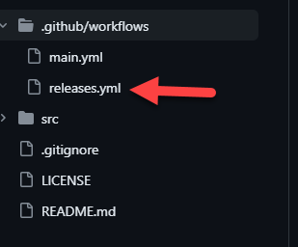
release branch - Live demos
Available at https://github.com/LanceMcCarthy/BostonCodeCamp36Demo, in .github/workflows/release.yml.
This is nearly identical to the main.yml, with a few key exceptions.

Slide 18
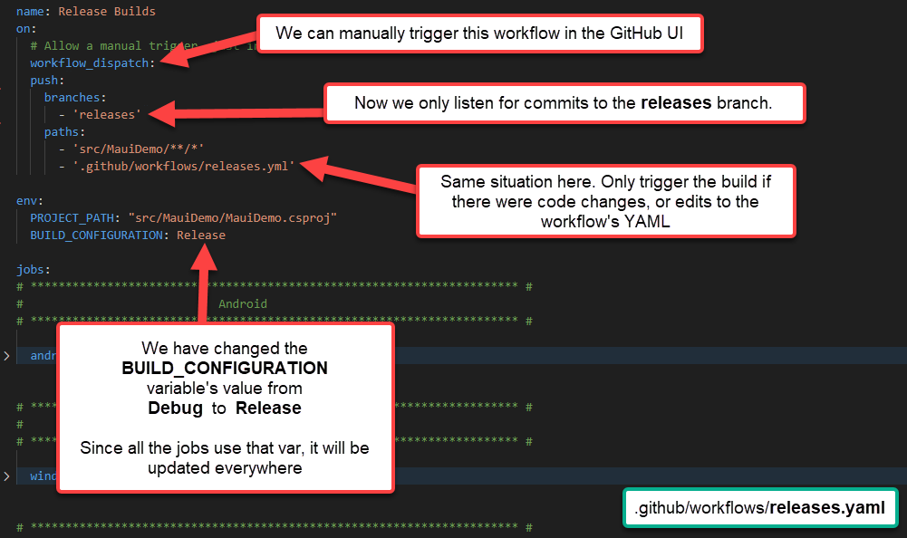
Workflow configuration

Slide 19
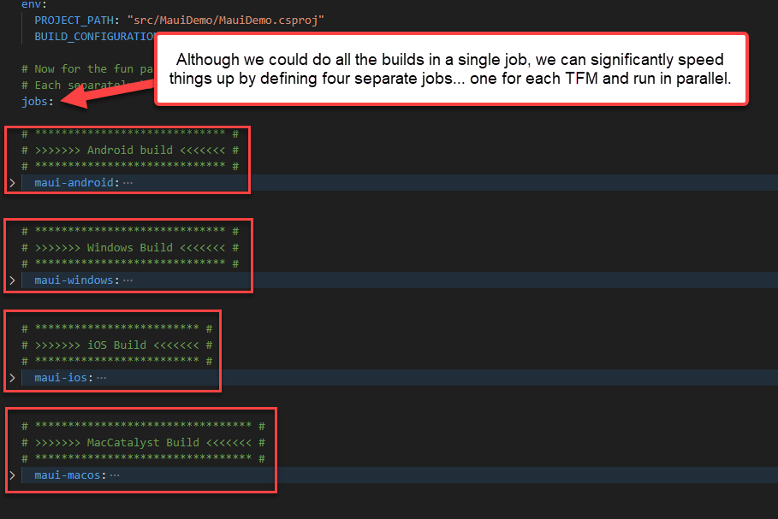
Workflow configuration

Slide 20
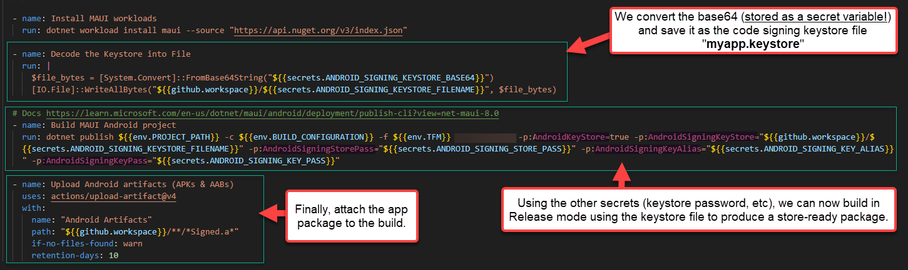
Android build (release)
Notes:
Your keystore file is converted ahead of time to base64 and saved as a GitHub Action secret. This allows us to convert it back to a file here and use it to sign the package.
You can upload directly to Google Play Console for distribution, there are helper GitHub Actions to accomplish this. See https://github.com/marketplace/actions/upload-android-release-to-play-store

Slide 21
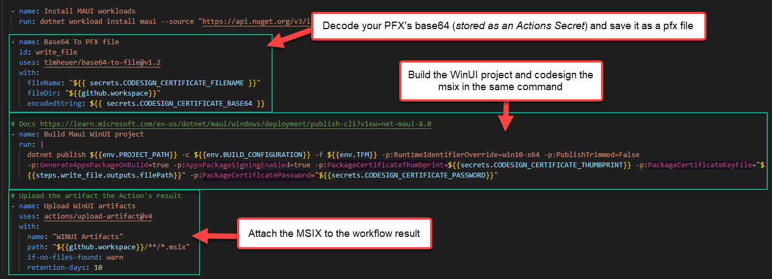
windows build (release)
Notes:
Similar to the Android job, you have previously saved your codesigning certificate as base64 in a GitHub Actions Secret (in the repo’s settings). Converting the base64 back to a PFX file allows you to sign the build
You can also upload the MSIX to Microsoft Partner Center for distribution, there are helper GitHub Actions to accomplish this. See https://github.com/marketplace/actions/microsoft-store-publish

Slide 22
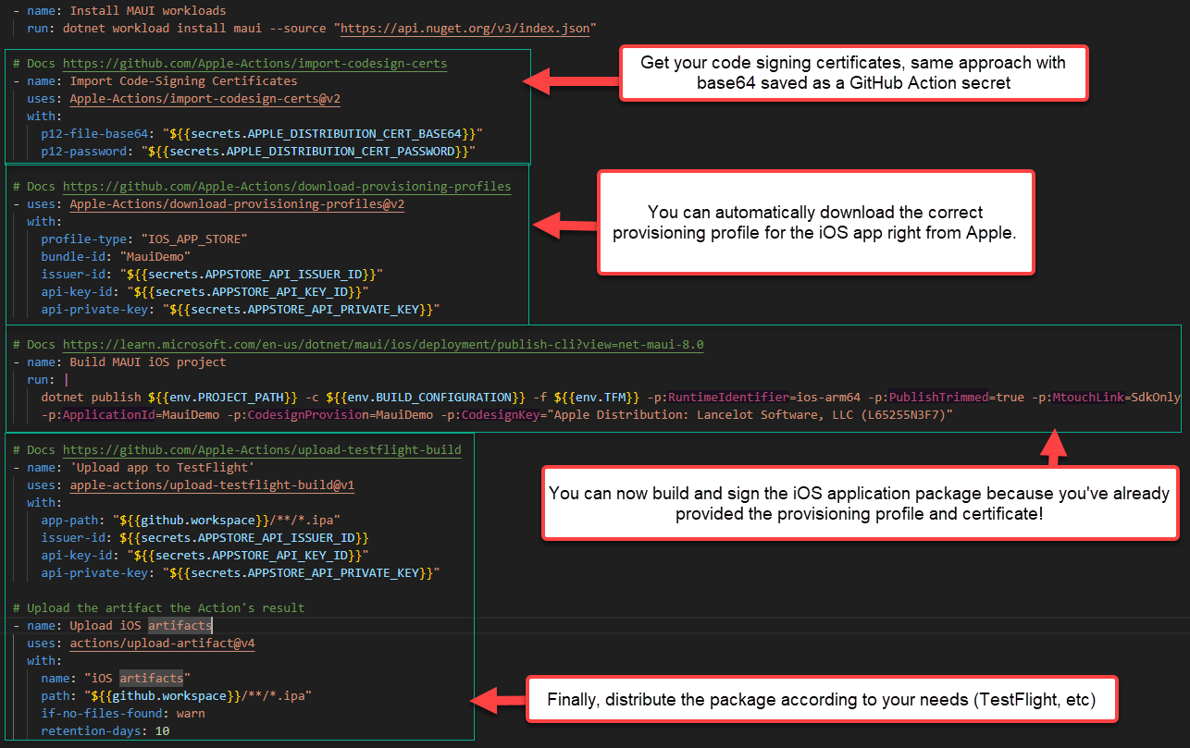
ios build (release)

Slide 23
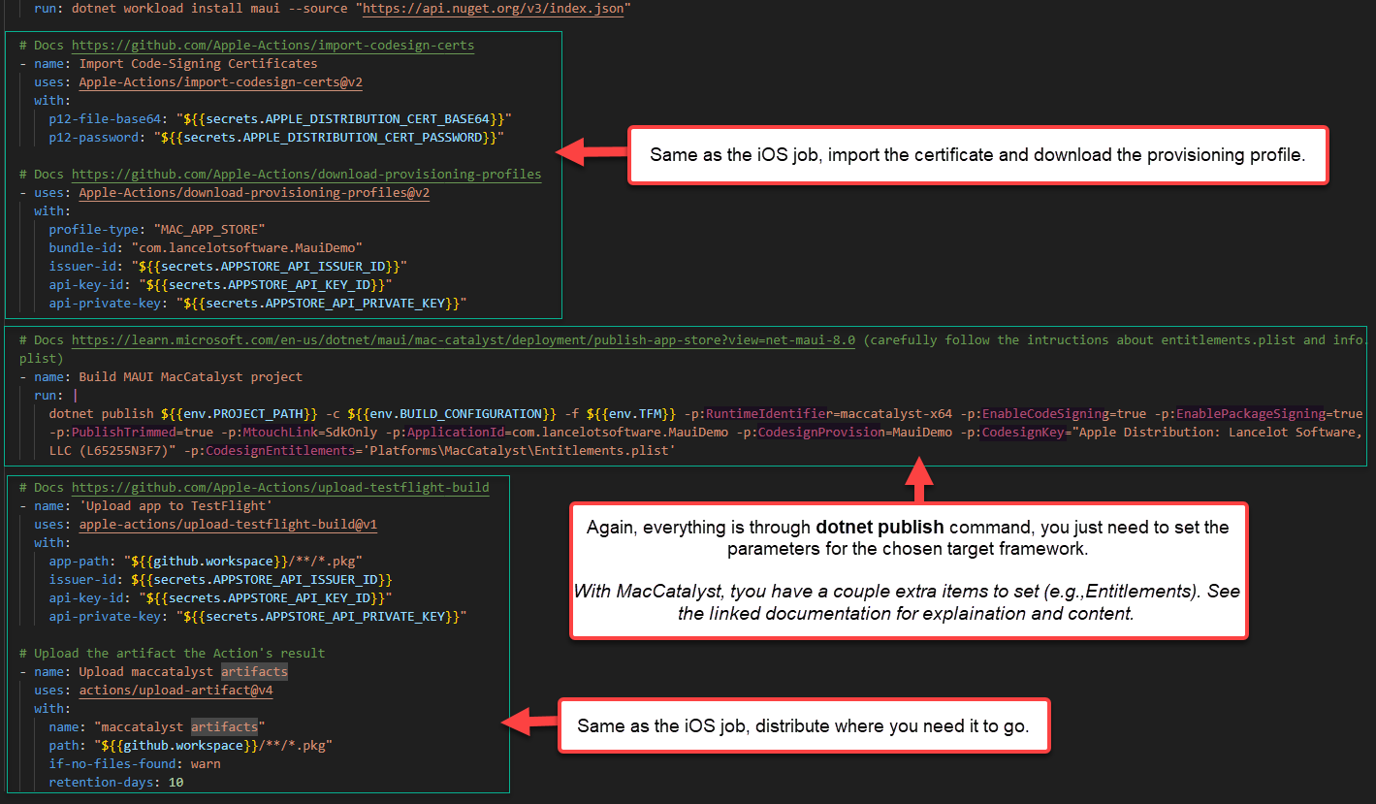
maccatalyst build (release)

Slide 24

PRO-Tips

Slide 25
Final tips & takeaways
Plan extra time when adding your first workflow/pipelines
You can have many initial failed builds; usually due to invalid YAML, the command isn’t perfect yet, you forgot to set a secret, etc.
Iterate quickly: manually cancel the workflow when one job fails (you don’t need to wait, cancel bad job, push changes again).
Use on:workflow_dispatch: when first writing the workflow so you can manually trigger it to test your YAML more quickly. Once everything is working, you can remove it.
Use “Conditional statements in the csproj
You can preset a lot of the release build specifics in the csproj, see the MauiDemo.csproj demo for examples
Write and test your CLI commands locally first
This is an easy way to speed up your implementation, if the “dotnet build param1 param2” is incorrect, it will fail locally
Use Secret variables
Don’t’ leak sensitive keys!!! Using secrets ensures keys, passwords, etc., are masked in the output and logs.
Don’t forget about shell-specific and platform-specific syntax
Bash and PowerShell have different capabilities. If you would only like to use PowerShell, you can set the shell to pwsh on Linux and MacOS runners
Paths separators are different on Windows than Linux/MacOS, use Path.Join() instead of string concatenation when dynamically building paths.
Try to always use GitHub-flavor variables ${{ env.MY_VAR }} instead of getting hung up on shell-specific flavors (which can make you go insane)
Bash uses $MY_VAR
PowerShell uses $env:MY_VAR
HUGE Tip – Double check your assumptions by outputting variables to log
If a command fails, and you’re using variables, output the variable to the log to verify that it holds the value you’re expecting.
E.g., echo ${{ env.MYVAR }} , right before you use My_VAR in your build command, to make sure it contains a value you’re expecting. Empty/incorrect variable values are a top reason things break.
Double checking variable values are what you expect, can save you hours of troubleshooting headache

Slide 26
Thank you
Lance McCarthy @l_anceM
Richard Hellwege @richardhellwege

